Slide 1
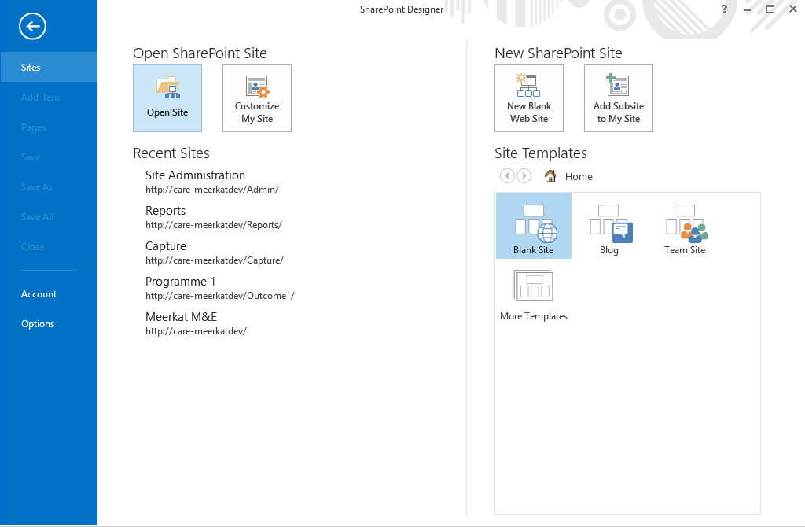
Open SharePoint Designer and click on open site

Slide 2
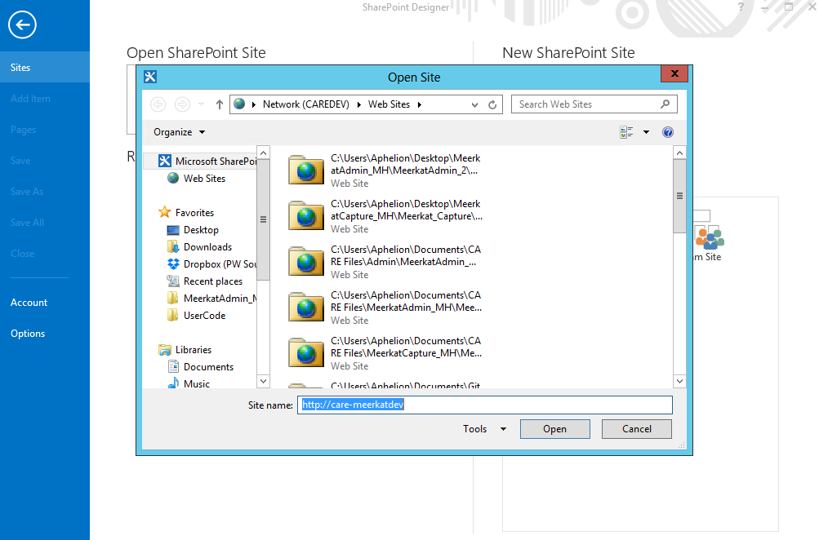
Input the url for the top site and click open

Slide 3
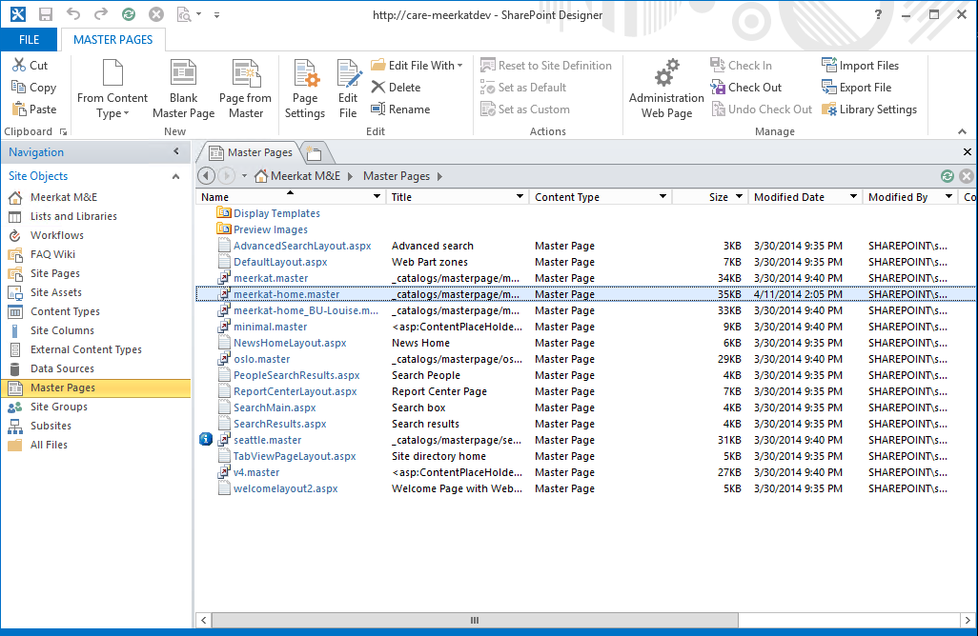
In the new window, click on Master Pages then Click on Meerkat-home.master to open it.

Slide 4
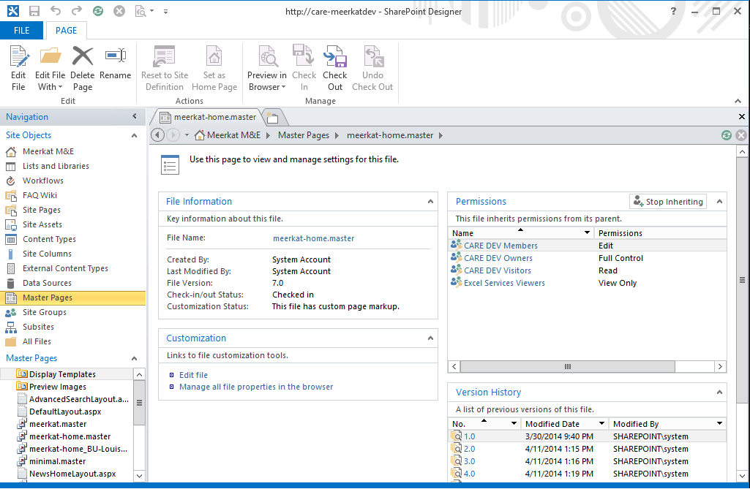
Click on edit file to start editing the masterpage

Slide 5
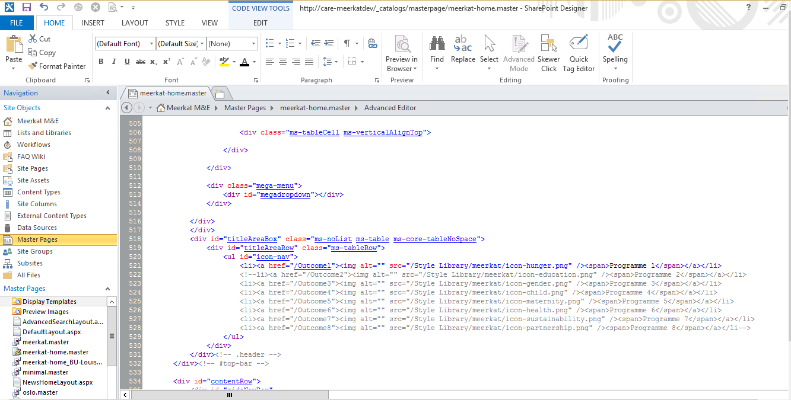
Edit the code for the top navigation. The greyed out section can be redeemed to include new sites and their icons and names that should go into the mega menu

Slide 6
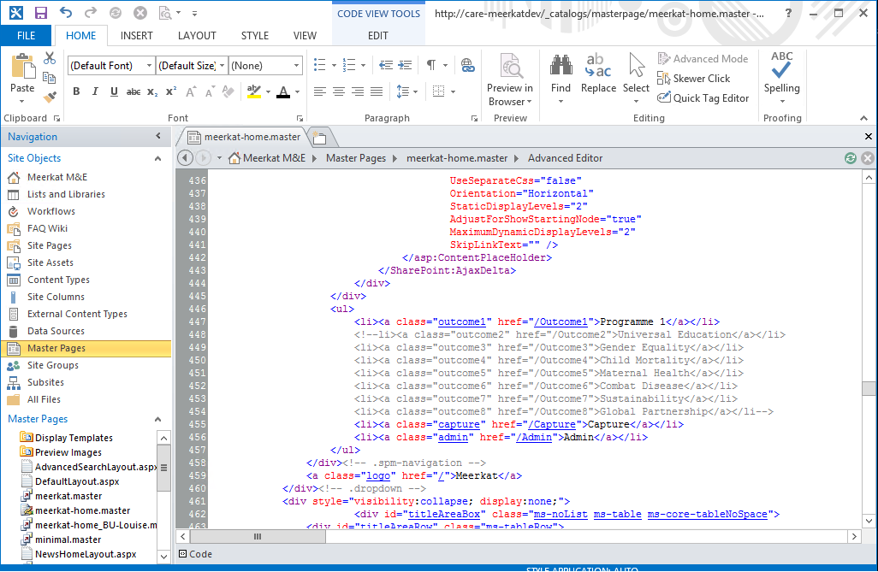
Edit the code for the side navigation accordingly with the proper site url and name. After this, save the work and return to the homepage.

Slide 7
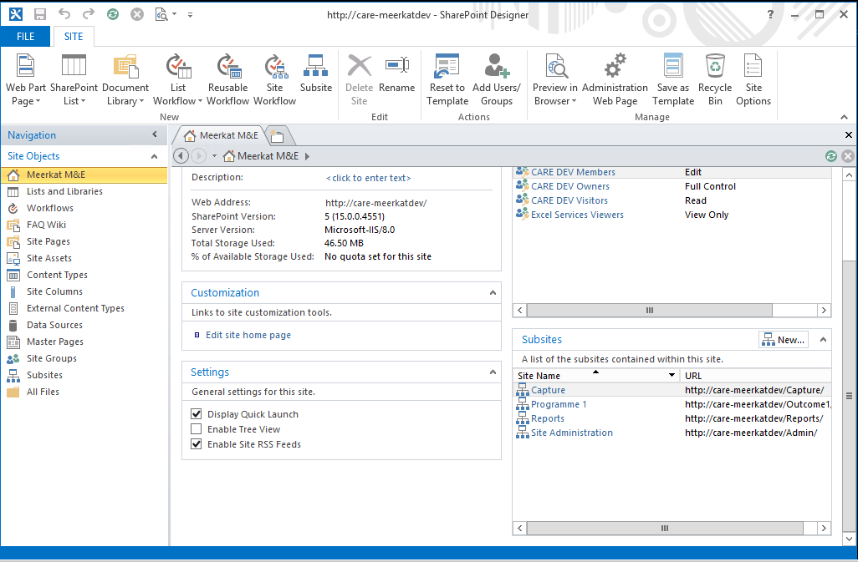
From the homepage click on a subsite to open it in a new window.

Slide 8
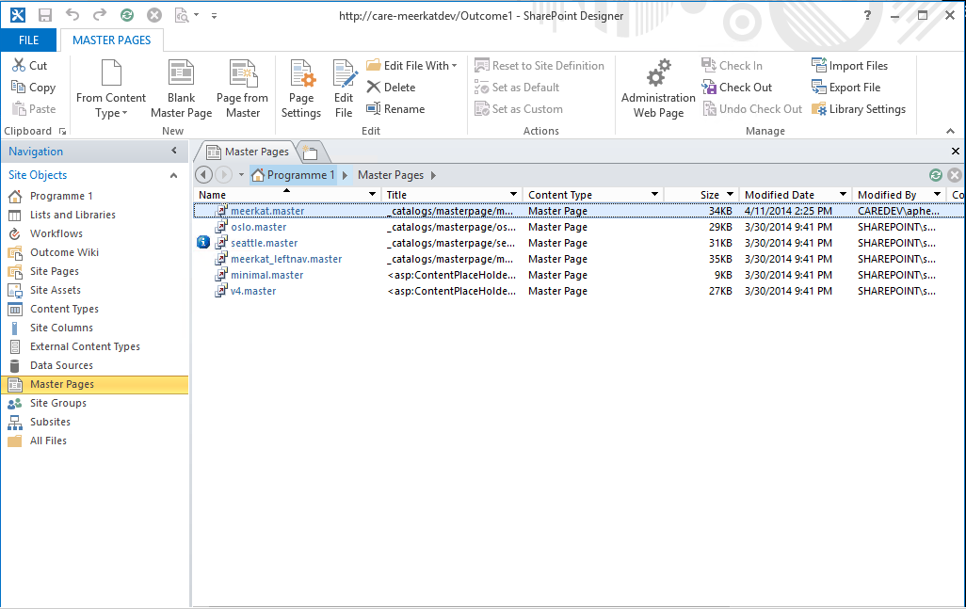
Click on masterpages and then Meerkat.master to edit it.

Slide 9
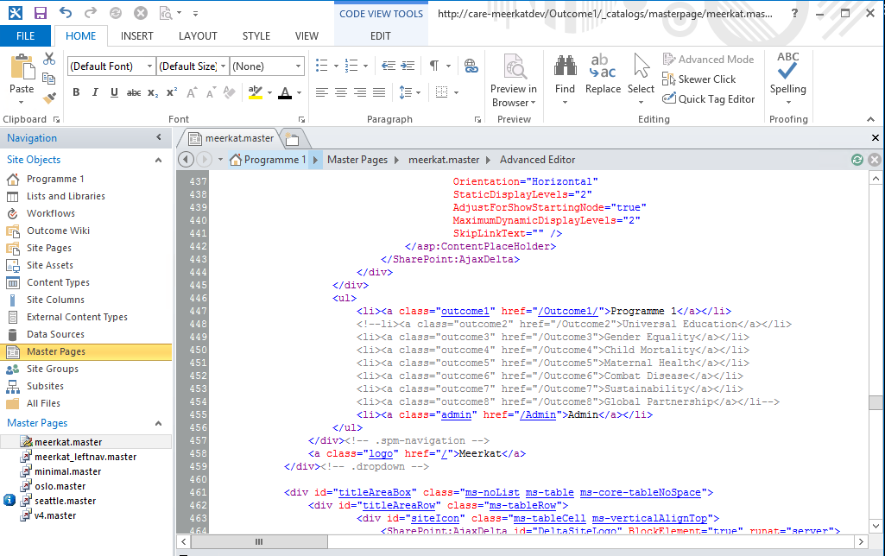
Edit the side navigation with the appropriate site url and name

Slide 10
Select Meerkat-home.master by clicking next to it and then click on export file to save it.

Slide 11
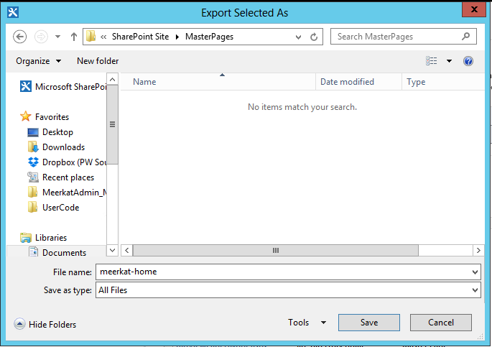
Save to the following path ..\Github\Meerkat\SharePointSite\MasterPages

Slide 12
Select Meerkat.master by clicking next to it and then click on export file to save it.

Slide 13
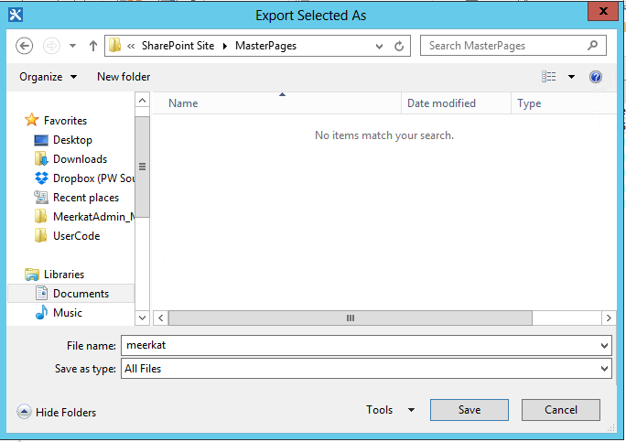
Save to the following path ..\Github\Meerkat\SharePointSite\MasterPages

Slide 14
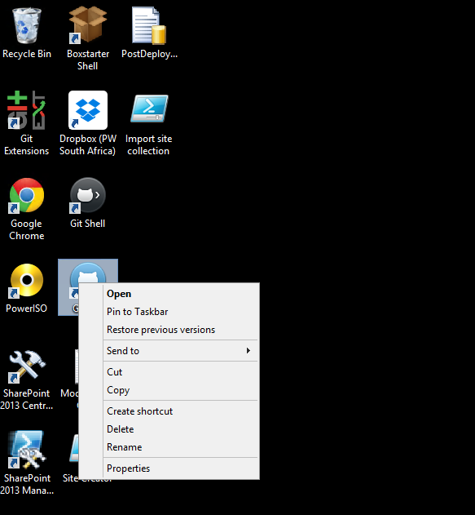
Open Github by clicking on the blue Github icon on the desktop.

Slide 15
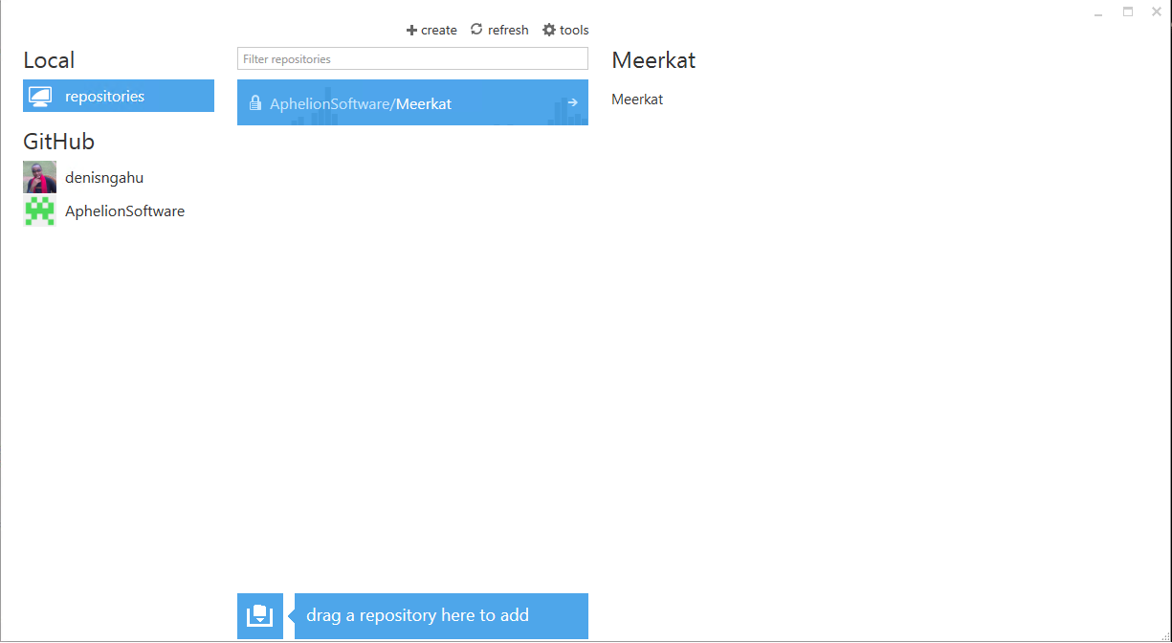
Open the local repository by clicking the arrow on the Meerkat repository.

Slide 16
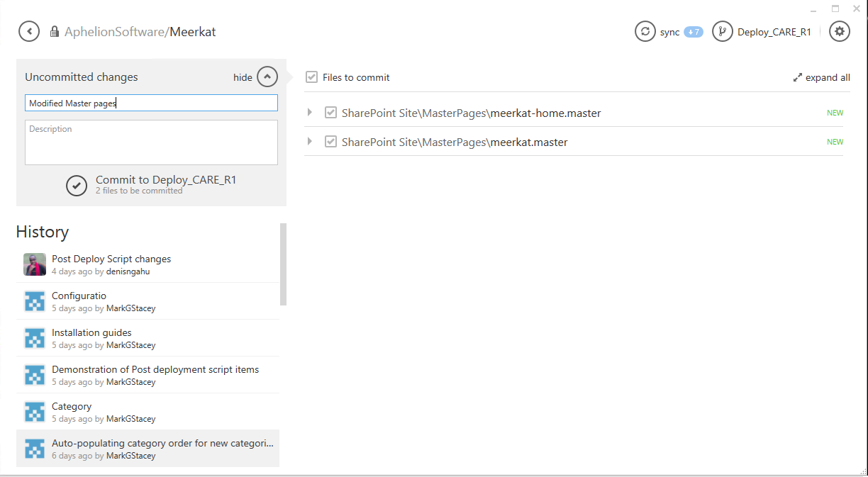
Choose the files you want to commit, provide a comment then click on the tick icon to commit. After that, hit the sync button to push back to Github.

